Slide 1










Securing understanding of multiplication with fractions
Task A: Comparing products
1) Use this fact to answer the following questions:
a)
b)
c)
d)
e)
f)
2) Without calculating, decide which is the greater product in each pair.
a)
b)
c)
d) Write the six products in order from smallest to largest.

Slide 2
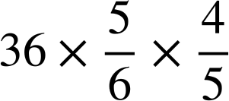
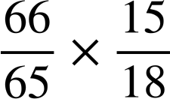
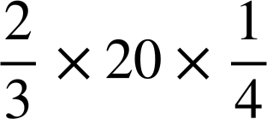
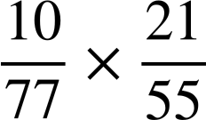
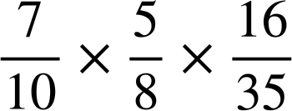
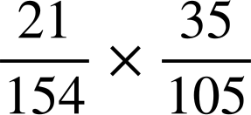
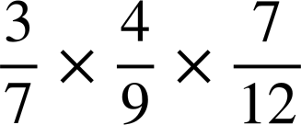
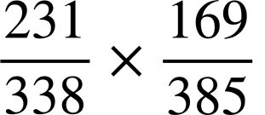
Securing understanding of multiplication with fractions
Task B: Multiplying two or more fractions
1) Use the most efficient method to answer these questions.
a)
b)
c)
d)
e)
f)
g)
h)
Mathematics in Education and Industry
v2.1

